Slide 1



Dipartimento di Ingegneria Industriale e dell’Informazione
via Roma 29, 81031 Aversa, Italy
MARUEEB project
561890-EPP-1-2015-1-IT-EPPKA2-CBHE-JP
Master Degree in InnovativeTechnologies in Energy Efficient Buildings for Russian & Armenian Universities and Stakeholders
Moisture Condensation and Thermo-Hygrometric Verification
Speaker: Oronzio Manca

Slide 2
Thermo-Hygrometric Verification
The thermo-hygrometric verification in building components has the purpose to determine the possible presence of condensate water vapor in a point or a zone of the examined component
⇓
The condensation development inside the building structure can determine
Humidity spots and/or
mould development
Deterioration of material mechanical and thermo-physical properties

Slide 3
CONDENSATION ON A SURFACE
Condensation on a surface phenomenon affects environments where internal walls reach temperature equal to or less than the dew point temperature for an assigned internal humidity and temperature values

Slide 4
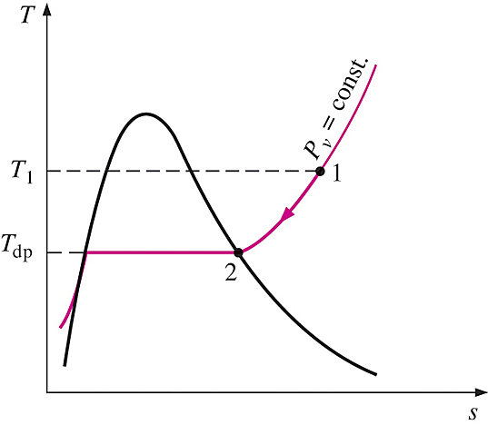
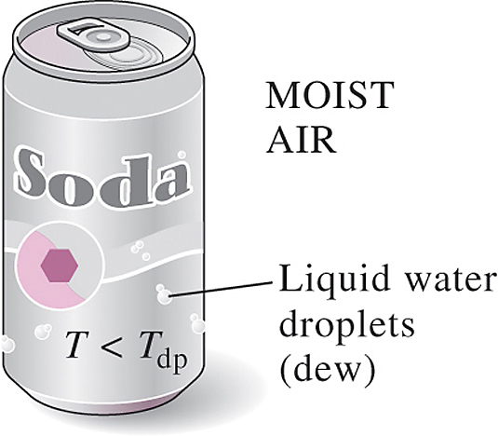
DEW-POINT TEMPERATURE
Dew-point temperature T_{dp}: The temperature at which condensation begins when the air is cooled at constant pressure (i.e., the saturation temperature of water corresponding to the vapor pressure.)
Constant-pressure cooling of moist
air and the dew-point temperature on
the T-s diagram of water.
When the temperature of a cold drink is below the dew-point temperature of the surrounding air, there are liquid droplets on the surface and the can surface “sweats.”

Slide 5
CONDENSATION ON A SURFACE
To avoid the condensation on a surface it is important to have the conditions inside the internal environment as indicated:
Partial pressure of the water vapor inside the internal environment
Saturation pressure related to the internal surface temperature, T_{i}

Slide 6
CONDENSATION ON A SURFACE
⇓
The real unknown of the problem is the temperature
internal surface whose determination
It is complicated by the presence of thermal bridges

Slide 7
CONDENSATION INSIDE A WALL
Building materials present in their structure many empty spaces with different dimensions. They are due to the manufacturing processes and the nature of the material
⇓
The empty spaces can be connected with the outside environment and/or connected inside among them or fully insulated i.e. each cavity is sealed

Slide 8
CONDENSATION INSIDE A WALL
Total porosity
Apparent porosity
⇩
⇩
Percentage ratio between the volume of voids and the overall volume of the material sample
Percentage of the volume ratio of empty communicating and the overall volume of the material sample
The pore connection is a necessary condition for the existence of a phenomenon of diffusion of water vapor within the material

Slide 9
VAPOR DIFFUSION
Vapor mass transfer in a medium or between several media in physical contact, due to a non-uniform pressure distribution
Darcy Law
⇓
where

Slide 10
VAPOR DIFFUSION
Hypothesis:
Isotropy
Homogeneous
⇓
Vapor mass flux ψ is proportional to the pressure gradient

Slide 11
VAPOR DIFFUSION
Permeability of the medium to the vapor
⇓
It is a physical property of the substance that characterizes his attitude to the vapor diffusion in the material

Slide 12
VAPOR DIFFUSION
[kg/(s m Pa)]
⇓
[kg/(h m mmHg)]

Slide 13
VAPOR DIFFUSION
Often it is employed the relationship between the vapor permeability of the material with respect to the vapor permeability of the air
⇓
μ

Slide 14
VAPOR DIFFUSION
⇩
The vapor permeability of materials is a function of temperature and pressure but due to the small variation of temperature in the building applications it is, generally, assumed constant
⇩
The regulations provide the permeability of building materials

Slide 15
THERMAL INSULATING MATERIAL
Cork boards
type | ρ [kg/m³] | m % | λ W/mK | δ_{a} 10⁻¹² kg/(s m Pa) | c kJ/(kg K) | δ_{u} 10⁻¹² kg/(s m Pa)
pure (humidity2-4%) | 130 | 10 | 0.045 | 6.7-10.0 | 2.1 | 6.7-10.0
expanded with binder (humidity 2-4%) | 90 130 200 | 10 | 0.043 0.045 0.052 | 6.7-10.0 4.0-21.0 4.0-21.0 | 2.1 2.1 2.1 | 6.7-10.0 4.0-21.0 4.0-21.0

Slide 16
VAPOR DIFFUSION
⇩
Thermo-hygrometric verification should be made using the permeability values in for dry air field
⇩
Generally, for thermo-hygrometric verification regulations suggest to choose the smaller values of δ_{a} for the materials placed toward the inner side of the wall (warm side) and the contrary for the materials placed towards the outer side of the wall (cold side)

Slide 17
Partial differential equation of mass vapor diffusion
y
x
z

Slide 18
Partial differential equation of mass vapor diffusion
Inlet mass flow rate of vapor in the control volume
Generate mass flow rate of vapor inside the control volume
+
=
Outlet mass flow rate of vapor from the control volume
Stored mass of vapor in the control volume
+
ψ_{y+dy}
y
ψ_{x}
ψ _{x+dx}
x
z
ψ _{z+dz}
ψ_{y}

Slide 19
Partial differential equation of mass vapor diffusion
Steady state regime
⇨
Stored mass of vapor in the control volume
ψ_{y+dy}
y
ψ_{x}
ψ _{x+dx}
x
z
ψ _{z+dz}
ψ_{y}

Slide 20
Partial differential equation of mass vapor diffusion
Excluding thermo-hygro- metrically not well designed walls
Generate mass flow rate of vapor inside the control volume
⇨
ψ_{y+dy}
y
ψ_{x}
ψ _{x+dx}
x
z
ψ _{z+dz}
ψ_{y}

Slide 21
Inlet mass flow rate of vapor
⇨
ψ_{y+dy}
y
ψ_{x}
ψ _{x+dx}
x
z
ψ _{z+dz}
ψ_{y}

Slide 22
Outlet mass flow rate of vapor
⇓
ψ_{y+dy}
y
ψ_{x}
ψ _{x+dx}
x
z
ψ _{z+dz}
ψ_{y}

Slide 23
Outlet mass flow rate of vapor
ψ_{y+dy}
y
ψ_{x}
ψ _{x+dx}
x
z
ψ _{z+dz}
ψ_{y}

Slide 24
Partial differential equation of mass vapor diffusion
⇓

Slide 25
Partial differential equation of mass vapor diffusion
⇓

Slide 26
Partial differential equation of mass vapor diffusion
If the vapor permeability to the medium is homogeneous along the three directions
⇓
In rectangular coordinate

Slide 27
Mass vapor diffusion in plane wall
Hypotheses:
Steady state regime
One dimensional condition
Homogenous and isotropic material
⇓

Slide 28
Mass vapor diffusion in plane wall
⇓

Slide 29
Mass vapor diffusion in plane wall
⇓
⇓

Slide 30
Mass vapor diffusion in plane wall
⇩
The trend of pressure vapor inside the wall is linear

Slide 31
Mass vapor diffusion in plane wall
⇩

Slide 32
Mass vapor diffusion in plane wall
⇩

Slide 33
Mass vapor diffusion in plane wall
K_{vt}=δA/L ⇨ Total permeance to the vapor
R_{vt}=L/δA ⇨ Total diffusive resistance to the vapor

Slide 34
Mass vapor diffusion in plane wall
⇩
K_{v}=W=δ/L ⇨ Permeance to the vapor
R_{v}=Z=L/δ ⇨ Diffusive resistance to the vapor

Slide 35
It is possible to establish an analogy with heat transfer by conduction.
As the thermal energy is diffused within a wall in the direction of decreasing temperatures, similarly the vapor is diffused in the direction of decreasing pressures.
Vapor permeability[kg/s m Pa]
δ
Material properties
λ
Thermal conductivity [W/m K]

Slide 36
… the properties with circle describe the attitude of the material to be crossed by:
λ
δ
… conductive heat flux
… mass diffusion

Slide 37
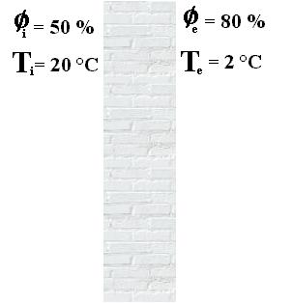
Exemple 1
p_{vs}(20°C) = 2338 Pa
p_{vs}(2°C) = 714 Pa
p_{vi} = p_{vs}(20°C)*φ_{i} =2338*0.5 =
=1169 Pa
p_{ve}= p_{vs}(2°C)*φ_{e} =714*0.8 =571 Pa
Δp_{v} =1169-571 = 598 Pa
The driving force to move the vapor is
Δp_{v} = 598 Pa

Slide 38
Composite wall in series
Composite wall in parallel

Slide 39
GENERATION OF WATER VAPOR
The most common sources of latent heat that can cause an internal generation of water vapor in an ambient are:
breathing and perspiration of people staying within the ambient
some typical processes that take place inside a home, such as: cooking food, hot showers, and so on)

Slide 40
GENERATION OF WATER VAPOR
Reason | Quantity g/h
Gas cooker
- small (about 5 cm) | 100
- medium (about 9 cm) | 200
- large (about 16 cm) | 400
Food cooking
- pot without lid, d=20 cm, with boiling water | 900
- Pot with lid, d=20 cm, with boiling water | 350
- Used mean value | 400

Slide 41
GENERATION OF WATER VAPOR
Reason | Quantity g/h
Hot shower | 2000
Hot bath in tub | 300
Clothes hung out to dry
- 5 kg in environment at 20°C and φ=40% | 200
People
- In rest | 50
- In light activity | 100
- in light work | 200
- In heavy work or gymnastics | 400

Slide 42
GENERATION OF WATER VAPOR
The mass flow rate of water vapor produced determines a variation of the thermodynamic conditions of humid air into the environment
⇩
The temperature and humidity verification of a wall is carried out by assigning the following boundary conditions :
outside temperature equal to the monthly average outdoor temperature reported for the individual locations in the specific regulations
external relative humidity equal to 90%
internal air temperature equal to 20°C
internal relative humidity equal to 70%

Slide 43
GENERATION OF WATER VAPOR
The verification of the condition p_{v}<p_{vs} allows to ensure the correct thermo-hygrometric operation of the walls
⇩
The responsibility for any anomalies can be attributed only to a dwelling misuse
⇩
For “improper” use, it means a too high humidity production related to a failure to implement the necessary fresh air renew

Slide 44
CONDENSATION INSIDE A WALL
In order not to have condensation on the inside or on the surface of a wall interface, in each point of the considered wall the following condition must always satisfied
⇩
⇩
It is necessary to know the trend of the water vapor saturation pressures in the various layers that make up the composite wall

Slide 45
CONDENSATION INSIDE A WALL
The pressure saturation condition is a function of the temperature
⇩
It is possible to evaluate the trend water vapor saturation pressures once the trend of temperatures in the wall is known

Slide 46
CONDENSATION INSIDE A WALL
The variation of p_{vs} inside the single layers can be assumed linear with a good approximation
⇩
It is sufficient to determine only the temperatures and, consequently, the corresponding saturation pressures, at the interfaces between the different layers of the wall to identify the p_{vs} distribution inside the wall

Slide 47
CONDENSATION INSIDE A WALL
For assigned geometry of the wall and thermophysical properties of the various layers it is necessary to:
calculate the overall transmittance per unit of surface
calculate the heat flux that passes through the wall by means of the Fourier law

Slide 48
CONDENSATION INSIDE A WALL
determine the temperature at the interface between two adjacent layers by means of the Fourier equation for the wall
from temperature values at the interface between the layers, it is possible to determine the corresponding values of the saturation pressure
by means of these values it is possible to obtain a diagram of saturation pressures as a function of the current abscissa and assuming that the p_{vs} variation is linear in each layers

Slide 49
CONDENSATION INSIDE A WALL
using the temperature values of the internal and external air, the appropriate values of the saturated vapor pressure are evaluated
by means of these pressure values and the relative humidity values of the internal and external air, it is possible to evaluate the corresponding values of the partial vapor pressure

Slide 50
CONDENSATION INSIDE A WALL
for assigned geometric and hygrometric characteristics of the different layers of the wall, the overall unitary permeance is determined
known the vapor pressure gradient of the composite wall, the water vapor flux is evaluated as:

Slide 51
CONDENSATION INSIDE A WALL
once the water vapor flux is known, applying iteratively the Fick equation, the vapor pressure at the interface between the various layers is determined:
Note the point values of the water vapor pressure at the interfaces between the different layers, it is possible to built the vapor pressure diagram as a function of the abscissa x
by means of the comparison between the local pvs and pv at the interface between the different layers and the(pv,x) e (pvs,x) diagrams overlapping is possible to determine the presence of condensation phenomena and how large the affected zone is

Slide 52
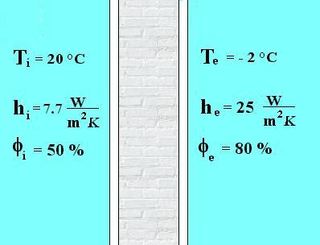
Example 2
a: gypsum plaster
thickness = 0.030 [m]
thermal conducivity = 0.35 [W/mK]
permeability = 18*10⁻¹² [kg/smPa]
b: bricks (ρ=800 kg/m³)
thickness = 0.30 [m]
thermal conducivity = 0.30 [W/mK]
permeability = 27*10⁻¹² [kg/smPa]
c: mortar cement
thickness = 0.04 [m]
thermal conductivity = 1.4 [W/mK]
permeability = 9*10⁻¹² [kg/smPa]
interno
esterno

Slide 53
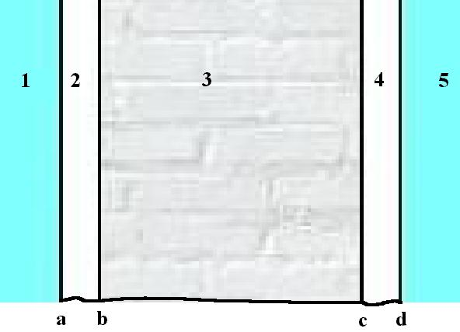
Example 2
⇩

Slide 54
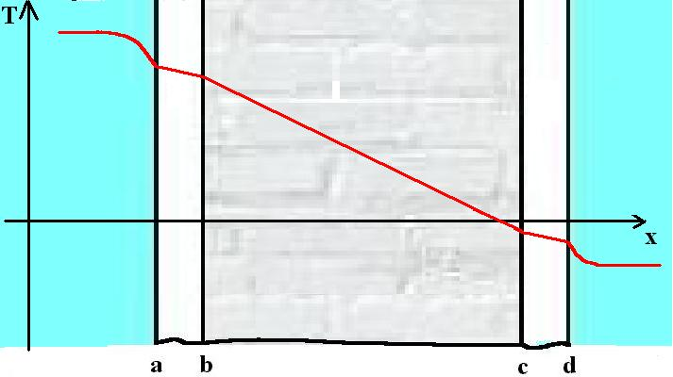
Example 2

Slide 55
Example 2

Slide 56
Example 2
With temperature values known, it is possible to calculate the saturated vapor pressure values
⇩

Slide 57
Example 2
Due to the difference of temperature and relative humidity between internal and external environment there is a difference between the water vapor partial pressures:

Slide 58
Example 2
If it is assumed that the resistance to water vapor at the interfaces a-internal and d-external are zero because p_{va} = p_{vi} e p_{vd} = p_{ve} water vapor flux will be given by the following relationship:

Slide 59
It is possible to evaluate the intermediate vapor pressure
⇩

Slide 60
By means the numerical evaluated data it is possible to carry out the Glaser diagram which valid in the following hypoteses:
⇩
Mass transfer due to only by diffusion
Steady state regime, i. e., temperature and vapor pressure (concentration) fields constant with respect to the time
Mass and energy transfer one-dimensional

Slide 61
The Glaser diagram is obtained by plotting the water vapor pressure, p_{v}, and the corresponding vapor saturation pressure, p_{vs}, as a function of x
⇩
By means of the diagram it is possible to detect if some area inside the wall, is p_{v}>p_{vs} and then highlight the possible formation of interstitial condensation (inside the wall condensation)

Slide 62
c d e
i a b
CONDENSATION ZONE

Slide 63
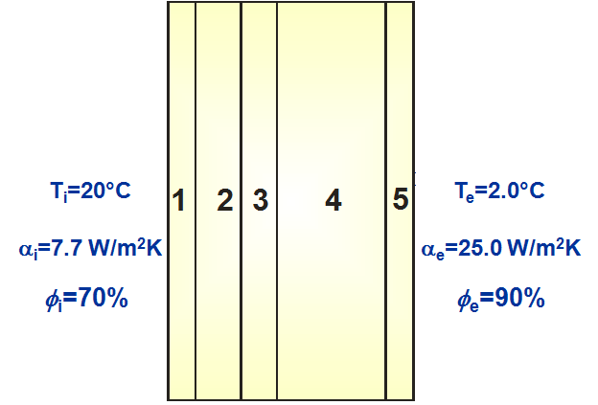
Example 3
Consider a wall of separation between an external environment to the temperature of 2.0 ° C and an internal environment at a temperature of 20 ° C consists of 5 different layers
internal environment
external environment
interno

Slide 64
Example 3
Layer-material | ρ [kg/m³] | s [m] | λ [W/mK] | α [W/m²K]
Internal gypsum plaster | 1200 | 0.02 | 0.35 | -
Concrete with expanded clay | 1700 | 0.07 | 0.75 | -
Space between walls | 1.3 | 0.04 | - | 6.40
Concrete with expanded clay | 1700 | 0.10 | 0.82 | -
External lime and gypsum plaster | 1400 | 0.02 | 0.70 | -

Slide 65
Example 3
⇩

Slide 66
Example 3
⇩

Slide 67
Example 3

Slide 68
With temperature values known it is possible to evaluate the vapor saturation pressure values
⇩

Slide 69
Due to the difference of temperature and relative humidity between internal and external environment there is a difference between the water vapor partial pressures:

Slide 70
Layer-material | ρ [kg/m³] | s [m] | δ_{a} [kg/s m Pa]
Internal gypsum plaster | 1200 | 0.02 | 18*10⁻¹²
Concrete with expanded clay | 1700 | 0.07 | 18*10⁻¹²
Space between walls | 1.3 | 0.04 | 193*10⁻¹²
Concrete with expanded clay | 1700 | 0.10 | 36*10⁻¹²
External lime and gypsum plaster | 1400 | 0.02 | 18*10⁻¹²

Slide 71
If it is assumed that the resistance to water vapor at the interfaces a-internal and g-external are zero because p_{va} = p_{vi} e p_{vd} = p_{ve} water vapor flux will be given by the following relationship:

Slide 72
⇩

Slide 73
It is possible to evaluate the intermediate vapor pressure
⇩

Slide 74
⇩

Slide 75
f g e
i a b
c d
CONDENSATION ZONE

Slide 76
METHODS TO ELIMINATE THE CONDENSATION
Verified the existence of the condensation phenomenon inside a wall or on the wall surfaces it is necessary to identify the appropriate constructive operations to eliminate the condensation

Slide 77
METHODS TO ELIMINATE THE CONDENSATION
The possible techniques to eliminate the condensation should allow:
a) increase the saturated vapor pressure values in the affected area with the condensation in order to have their values higher than the values of p_{v}
b) reducing the vapor partial pressure values in the affected area with the condensation in order to realize that they are lower than the values of p_{vs}
c) modifying together in an appropriate way the values of p_{v} e p_{vs} in order to obtain p_{v}<p_{vs}

Slide 78
METHODS TO ELIMINATE THE CONDENSATION
The method a) is based on the consideration that the temperature difference between the inside and the outside, and then the variation of the p_{vs}, is shared among the different layers of the wall in relation to the thermal resistance of each layer
⇩
The greater temperature difference takes place in layers that have a higher thermal resistance
⇩
This phenomenon is more significant in thermal insulation layer

Slide 79
METHODS TO ELIMINATE THE CONDENSATION
In a generic composite wall with different layers the temperature diagram in terms of geometric variable can be different depending on the arrangement of the different layers
⇩
How much more the layer with higher resistance is external the lower the partial temperature gradient between the internal interface and the external surface of this layer

Slide 80
METHODS TO ELIMINATE THE CONDENSATION
A possible intervention to remove the condensate consists in positioning an insulating material as outer layer. This determines that the inner part of the wall remain hot and dry
⇩
Having been introduced an additional layer of the wall is necessary to completely re-check its behavior, both from a thermal point of view that hygrometric

Slide 81
Example 4
With reference to the example 3, it is introduced a 3 cm thick extruded polystyrene material layer applied on the inside of the wall of the air chamber
interno

Slide 82
Example 4
Layer-material | ρ [kg/m³] | s [m] | λ [W/mK] | α [W/m²K]
Internal gypsum plaster | 1200 | 0.02 | 0.35 | -
Concrete with expanded clay | 1700 | 0.07 | 0.75 | -
Space between walls | 1.3 | 0.01 | - | 6.40
Extruded polystyrene | 30 | 0.03 | 0.043 | -
Concrete with expanded clay | 1700 | 0.10 | 0.82 | -
External lime and gypsum plaster | 1400 | 0.02 | 0.70 | -

Slide 83
⇩

Slide 84
⇩

Slide 85
⇩

Slide 86
With temperature values known it is possible to evaluate the vapor saturation pressure values
⇩

Slide 87
⇩

Slide 88
Due to the difference of temperature and relative humidity between internal and external environment there is a difference between the water vapor partial pressures:

Slide 89
Esempio 4
Layer-material | ρ [kg/m³] | s [m] | δ_{a} [kg/s m Pa]
Internal gypsum plaster | 1200 | 0.02 | 18*10⁻¹²
Concrete with expanded clay | 1700 | 0.07 | 18*10⁻¹²
Space between walls | 1.3 | 0.01 | 193*10⁻¹²
Extruded polystyrene | 30 | 0.03 | 2.2*10⁻¹²
Concrete with expanded clay | 1700 | 0.10 | 36*10⁻¹²
External lime and gypsum plaster | 1400 | 0.02 | 18*10⁻¹²

Slide 90
⇩

Slide 91
It is possible to evaluate the intermediate vapor pressure
⇩

Slide 92
⇩

Slide 93
g h e
i a b
c d f

Slide 94
METHODS TO ELIMINATE THE CONDENSATION
With reference to method b), it is evident that if it is placed a layer with a high resistance to vapor diffusion inside the wall, the highest pressure drop will be attained in this layer
⇩
At same hygrometric boundary conditions, the remaining variation of pressure between that layer and the external environment will be considerably reduced
⇩
In this zone the water vapor pressure values will be lower

Slide 95
METHODS TO ELIMINATE THE CONDENSATION
The phenomenon of vapor diffusion in a solid is related to the presence of a strong connection among the pores
⇩
A material can have a high resistance to water vapor
Or because its porosity is low
Or because the cavities are not communicating

Slide 96
METHODS TO ELIMINATE THE CONDENSATION
To the first category belong the vapor barriers
⇩
They have a high density and low permeability to water vapor, of the order of 10⁻⁶ – 10⁻⁹ g/(h m mmHg)
⇩
Examples are: aluminum sheets, polyethylene sheets, paper treated with bitumen ….

Slide 97
Example 5
With reference to the example 3, it is considered, immediately after the internal plaster, a vapor barrier formed by a sheet of cardboard tarred 0.1 mm

Slide 98
Example 5
Layer-material | ρ [kg/m³] | s [m] | λ [W/mK] | α [W/m²K]
Internal gypsum plaster | 1200 | 0.02 | 0.35 | -
Cardboard tarred | - | 0.0001 | 0.5 | -
Concrete with expanded clay | 1700 | 0.07 | 0.75 | -
Space between walls | 1.3 | 0.04 | - | 6.40
Concrete with expanded clay | 1700 | 0.10 | 0.82 | -
External lime and gypsum plaster | 1400 | 0.02 | 0.70 | -

Slide 99
Example 5
This thermal resistance is of two orders of magnitude lower than the thermal resistances of the other layers
⇩
It follows that the temperature and saturation pressure, p_{vs}, values remain identical to that of the multilayer wall without cardboard tarrer

Slide 100
Example 5
⇩

Slide 101
Example 5
⇩

Slide 102
Example 5
⇩

Slide 103
With temperature values known it is possible to evaluate the vapor saturation pressure values
⇩

Slide 104
Example 5
⇩

Slide 105
Example 5
Due to the difference of temperature and relative humidity between internal and external environment there is a difference between the water vapor partial pressures:

Slide 106
Example 5
Layer-material | ρ [kg/m³] | s [m] | δ_{a} [kg/s m Pa]
Internal gypsum plaster | 1200 | 0.02 | 18*10⁻¹²
Cardboard tarred | - | 0.0001 | 2.11*10⁻¹⁴
Concrete with expanded clay | 1700 | 0.07 | 18*10⁻¹²
Space between walls | 1.3 | 0.04 | 193*10⁻¹²
Concrete with expanded clay | 1700 | 0.10 | 36*10⁻¹²
External lime and gypsum plaster | 1400 | 0.02 | 18*10⁻¹²

Slide 107
Example 5
⇩

Slide 108
Example 5
It is possible to evaluate the intermediate vapor pressure
⇩

Slide 109
Example 5
⇩

Slide 110
Example 5
g h e
i a b-c
d f

Slide 111
METHODS TO ELIMINATE THE CONDENSATION
With reference to method c) It must note that in the vapor barriers are included those materials which have a low apparent porosity
⇩
In these material all those thermal insulating materials, which have the characteristic closed-cell structure, are included. These materials guarantees a good thermal resistance
⇩
These materials have a good resistance to vapor diffusion by virtue of their thickness of the order of a few cm , thought they do not present low δ_{a}

Slide 112
METHODS TO ELIMINATE THE CONDENSATION
The use of the insulation from a hygrometric point of view can not be separated from its thermal influence on the wall
⇩
By contrary, it is noted that the insulating material placed on the inner face of the wall has the advantage to achieve a solution that involves a small thermal inertia of the wall system

Slide 113
METHODS TO ELIMINATE THE CONDENSATION
⇩
i.e. a prompt response to the thermal transient of the heated environments for the starting of the heating system after a switching off period
⇩
A solution that average the two requirements consists in the contemporary use of a vapor barrier and a thermal insulating material

Slide 114
EVALUATION OF THE VAPOR BARRIER THICKNESS
If it is necessary to introduce a vapor barrier its minimum thickness should be evaluated in order to eliminate the condensate
⇩
The procedures to identify this value are both analytical and graphics

Slide 115
EVALUATION OF THE VAPOR BARRIER THICKNESS
Analytical procedure
⇩
the calculation procedure to determine the vapor pressure as a function of vapor barrier thickness should be iterated up to identify the minimum value that satisfies the assigned condition

Slide 116
EVALUATION OF THE VAPOR BARRIER THICKNESS
Analytical procedure
⇩
to obtain a fast convergence of the procedure, the hygrometric behavior of the wall can be determinate using two limit values of the vapor barrier thickness
⇩
As the upper limit value a thickness of an order of magnitude of a few tenths of a mm can be considered and the lower limit value can be a thickness of an order of magnitude of a few hundredths of a mm

Slide 117
EVALUATION OF THE VAPOR BARRIER THICKNESS
Analytical procedure
⇩
Using the bisection method an estimation of a well approximate value of the minimum thickness is carried out
⇩
It is clear that for each iteration of the method it is necessary to calculate the vapor pressure values whereas the saturation pressure can be considered constant because the thermal resistance can be considered negligible due to the small thickness of the vapor barrier

Slide 118
EVALUATION OF THE VAPOR BARRIER THICKNESS
The analytical process is extremely laborious
⇩
the determination of the vapor barrier thickness using the graphical method has simpler implementation

Slide 119
EVALUATION OF THE VAPOR BARRIER THICKNESS
internal environment
external environment
interno

Slide 120
⇩

Slide 121
B’
B
C
A

Slide 122
EVALUATION OF THE VAPOR BARRIER THICKNESS
The BB 'segment in the abscissa axis scales represents the resistance value to water vapor of the layer that should be added to the wall in order to prevent condensation
⇩
Note the resistance to water vapor to be added and identified the type of the vapor barrier to be used and therefore its permeability, it is possible to determine the thickness of this layer univocally

Slide 123
EVALUATION OF THE VAPOR BARRIER THICKNESS
In the use of the graphical method it should be considered that:
the methodology employed allows to determine the thickness of the layer but it does not gives indications on where to place it
in the case of operations that use as barriers the thermal insulations, it should not be forgotten that their use modifies significantly the saturation pressure, p_{vs}
the resistance to the water vapor differs from material to material also of various orders of magnitude, then it follows the difficulty to buid a proper abscissa scale in the diagram to solve the problem

Slide 124
EVALUATION OF THE VAPOR BARRIER THICKNESS
In some cases also with the use of the vapor barrier it is not possible to eliminate completely the interstitial condensation.
⇩
However, it is reasonable to think that the negative effects of condensation are observable from threshold levels.

Slide 125
EVALUATION OF THE VAPOR BARRIER THICKNESS
In other words, it is assumed that a limited value of the amount of water accumulated, at the end of the condensation period, is compatible with the good conservation of materials
⇩
The phenomenon should necessarily be reversible that is the condensed water must evaporate before the next condensation period

Slide 126
EVALUATION OF THE VAPOR BARRIER THICKNESS
⇩
In this way, the average amount of liquid water present in the material in each annual cycle will be equal to zero.
⇩
However, it should be underlined that:
the testing of these phenomena is not yet sufficient to give an unambiguous interpretation for all cases

Slide 127
EVALUATION OF THE VAPOR BARRIER THICKNESS
⇩
In the opinion of some researchers, for some materials it may at present be considered tolerable maximum values of condensed water m_{lim} given in the regulations “of each country where it exists”

Slide 128
ACCEPTABLE CONDENSED WATER MASS IN MATERIALS

Slide 129

ACCEPTABLE CONDENSED WATER MASS IN MATERIALS
Considering a generic portion of a material inside a multilayer wall, by applying the principle of conservation of mass for the water vapor, in the steady state, it is:

Slide 130
ACCEPTABLE CONDENSED WATER MASS IN MATERIALS
Difference in partial vapor pressure between the inner surface and the starting point of the water vapor condensation.
Difference in partial vapor pressure between the end point of condensation and the outer surface.

Slide 131
ACCEPTABLE CONDENSED WATER MASS IN MATERIALS
Resistance to water vapor between the inner surface and the starting point of the condensation.
Resistance to steam between the end point of condensation and the outer surface.

Slide 132
EVALUATION OF CONDENSED WATER QUANTITY
The mass of water which condenses in a given period of time τ₁-τ₂ is defined as
⇩

Slide 133
EVALUATION OF CONDENSED WATER QUANTITY
⇩
The equation can be approximated by the sum of N values Δm_{c}
average specific mass flow rate during the time interval τ₁−τ₂

Slide 134
EVALUATION OF CONDENSED WATER QUANTITY
⇩

Slide 135
EVALUATION OF CONDENSED WATER QUANTITY
d_{i} = duration of the condensation period, expressed in days
d_{e} = duration of the evaporation period, expressed in days
⇩
It is possible to calculate the vapor condensed masses, m_{c}, and subsequently evaporated, m_{e}

Slide 136
EVALUATION OF CONDENSED WATER QUANTITY
Condensed mass
Evaporate mass

Slide 137
EVALUATION OF CONDENSED WATER QUANTITY
The condensate mass in the wall is acceptable if the following conditions are simultaneously valid

Slide 138
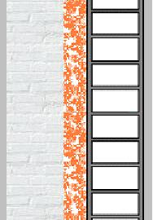
Example 6
Gypsum plaster
Clay-bricks
Glass wool panel
Hallow bricks
indoor:
T_{i} = 20°C φ_{i}=50 %
α_{i}=7.7 W/m²K
outdoor:
T_{e} = - 5°C φ_{e}=90 %
α_{e}=25 W/m²K
Lime plaster

Slide 139
Example 6
Layer-material | ρ [kg/m³] | s [m] | λ [W/mK]
1. Gypsum plaster | 1400 | 0.015 | 0.7
2. Bricks | 1000 | 0.08 | 0.36
3. Glass wool panel | 15 | 0.06 | 0.044
4. Hallow bricks | 1600 | 0.25 | 0.68
5. Lime plaster | 1400 | 0.015 | 0.9

Slide 140
Example 6
⇩

Slide 141
Example 6
⇩

Slide 142
Example 6
⇩

Slide 143
Example 6
With temperature values known it is possible to evaluate the vapor saturation pressure values
⇩

Slide 144
Example 6
⇩

Slide 145
Example 6
Due to the difference of temperature and relative humidity between internal and external environment there is a difference between the water vapor partial pressures:

Slide 146
Example 6
Layer-material | ρ [kg/m³] | s [m] | δ_{a} [kg/s m Pa]
1. Gypsum plaster | 1400 | 0.015 | 18*10⁻¹²
2. Bricks | 1000 | 0.08 | 18*10⁻¹²
3. Glass wool panel | 15 | 0.06 | 150*10⁻¹²
4. Hallow bricks | 1600 | 0.25 | 36*10⁻¹²
5. Lime plaster | 1400 | 0.015 | 12*10⁻¹²

Slide 147
Example 6
⇩

Slide 148
Example 6
It is possible to evaluate the intermediate vapor pressure
⇩

Slide 149
Example 6
⇩

Slide 150
Example 6
f g e
i a b
c d
Condensation !!!

Slide 151
The examination of the graph shows that at the interface d there is the maximum difference of pressure, therefore, this is the section where it is more likely the formation of condensation.
⇩
The water vapor pressure at this point can be at most equal to the saturation pressure this is p_{vd}=p_{vsd}= 600 Pa and the diagram should be modified considering unchanged the internal and external environmental conditions.
⇩
To determine the water vapor mass that condenses the mass vapor flux is evaluated to the right and to the left of the section d

Slide 152
Interface d

Slide 153
⇩
⇩

Slide 154
With ψ_{a-d} e ψ_{d-g} known, it is possible to evaluate the new water vapor pressure values in the sections b, c and f
⇩
Assuming as conventional duration of the winter condensation period d_{i} = 60 days, the condensed water vapor mass will be equal to:

Slide 155
The maximum amount of condensed water, m_{lim} , for mineral fibers, in the example it is glass fibers, that is:
Then the minimum requirements of the standard are not verified

Slide 156
Suppose to choose a fiberglass panel with ρ=30 kg/m³ and there is an increase of the limit vapor mass m_{lim}=428 g/m²
⇩
The first requirement is verified
⇩
Now it should be verified that the condensed water in the winter completely evaporate during the summer season.

Slide 157
⇩
indoor:
T_{i} = 18°C φ_{i}=70 %
outdoor:
T_{e} = 18°C φ_{e}=70 %
⇩

Slide 158
The vapor pressure in the section d It is just equal to the saturation pressure at 18°C
⇩

Slide 159
the output water vapor fluxes are

Slide 160
The vapor pressure values in the other inner sections can be evaluated
⇩

Slide 161
f g e
i a b
c d

Slide 162
⇩
⇩

Slide 163
Assuming as duration of the summer evaporation period equal to the conventional one to 90 days, it is obtained
⇩
⇩
The present structure, yet still give rise to water vapor condensation, is acceptable because m_{e}>m_{c}

