Slide 1
Dipartimento di Ingegneria Industriale e dell’Informazione
via Roma 29, 81031 Aversa, Italy
MARUEEB project 561890-EPP-1-2015-1-IT-EPPKA2-CBHE-JP
Master Degree in InnovativeTechnologies in Energy Efficient Buildings for Russian & Armenian Universities and Stakeholders
Thermal Bridges
Speaker: Oronzio Manca

Slide 2
THERMAL BRIDGE: main concepts
The heat transfer rate dispersed by a wall can be determined through the Fourier's law
⇓

Slide 3
THERMAL BRIDGE: main concepts
The evaluation can be carried out in a simple way under the following hypotheses:
Steady state regime
the material is isotropic and homogeneuos
the height and width of the wall are much larger than its thickness
the temperatures of the wall surfaces are uniform

Slide 4
THERMAL BRIDGE: main concepts
These assumptions allow:
Neglect the edge effects and, consequently
Consider the thermal field and the heat flux vector as a one-dimensional

Slide 5
The perimetral walls of the buildings are not perfectly homogeneous
⇓
Glazed windows or structural elements
⇓
beams, pillars and slabs

Slide 6
These elements determine differences in the thermal behavior in wall areas where they are present
⇓
Typically these elements values of λ have much higher than the ones of infill walls or masonry

Slide 7
Along the edges of the walls there are areas in which the hypothesis of one-dimensional flow is no longer satisfied
⇓
This is due to the couplings with the other walls or slabs
⇓
Both for the different thermal conductivity of the structures and for the particular geometry of the wall area

Slide 8
Geometric and structural configurations that produce deviations from the one-dimensional flow conditions
⇓
THERMAL BRIDGE ZONES

Slide 9
T_{e}
T₂
OUTDOOR
T
T_{i}
INDOOR
T₁
x

Slide 10
CLASSIFICATION OF THERMAL BRIDGES
Geometrical thermal bridge
Thermal bridge of structure
Mixed thermal bridge

Slide 11
CLASSIFICATION OF THERMAL BRIDGES
Geometrical thermal bridge
⇓
Portions of the considered domain where the deviation from the one-dimensional heat flux condition is due to the geometry of the structure

Slide 12
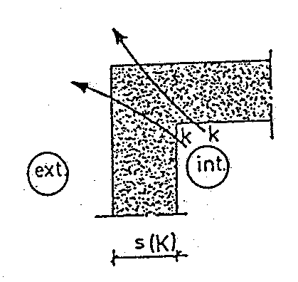
CLASSIFICATION OF THERMAL BRIDGES
Geometrical thermal bridge
Edge between two outer walls of the same structure

Slide 13
CLASSIFICATION OF THERMAL BRIDGES
Geometrical thermal bridge
T coupling between an outer wall and an inner wall of the same structure

Slide 14
CLASSIFICATION OF THERMAL BRIDGES
Thermal bridge of structure
⇓
Areas where the deviation from the one-dimensional heat flow condition is due solely to the presence in the wall of a building element having a different thermal conductivity λ

Slide 15
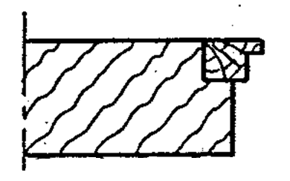
CLASSIFICATION OF THERMAL BRIDGES
Thermal bridge of structure
Junction between an outer wall and a casing (window)

Slide 16
CLASSIFICATION OF THERMAL BRIDGES
Thermal bridge of structure
Junction between an outer wall and a pillar inserted inside

Slide 17
CLASSIFICATION OF THERMAL BRIDGES
Mixed thermal bridge
⇓
Areas where there is an overlap of a geometrical and structure thermal bridges

Slide 18
CLASSIFICATION OF THERMAL BRIDGES
Mixed thermal bridge
T coupling between an outer wall and an inner wall of different structure or material

Slide 19
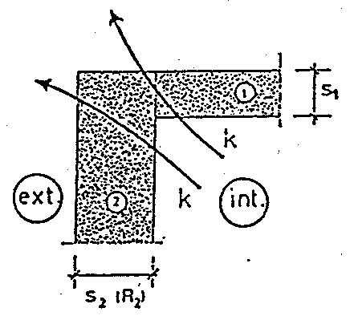
CLASSIFICATION OF THERMAL BRIDGES
Mixed thermal bridge
Edge between two outer walls of different structure or material

Slide 20
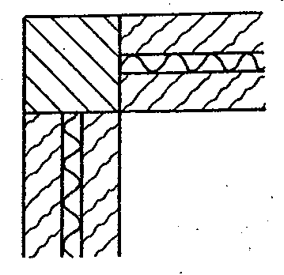
CLASSIFICATION OF THERMAL BRIDGES
Mixed thermal bridge
Corner pillar inserted in an external wall, different materials

Slide 21
THERMAL BRIDGE EFFECTS
In the thermal bridge areas the heat flux transmitted through the structure is different from the value calculated in the one-dimensional heat flux assumption
The existence of a two-dimensional or three-dimensional thermal field makes non-uniform the surface temperature of the walls

Slide 22
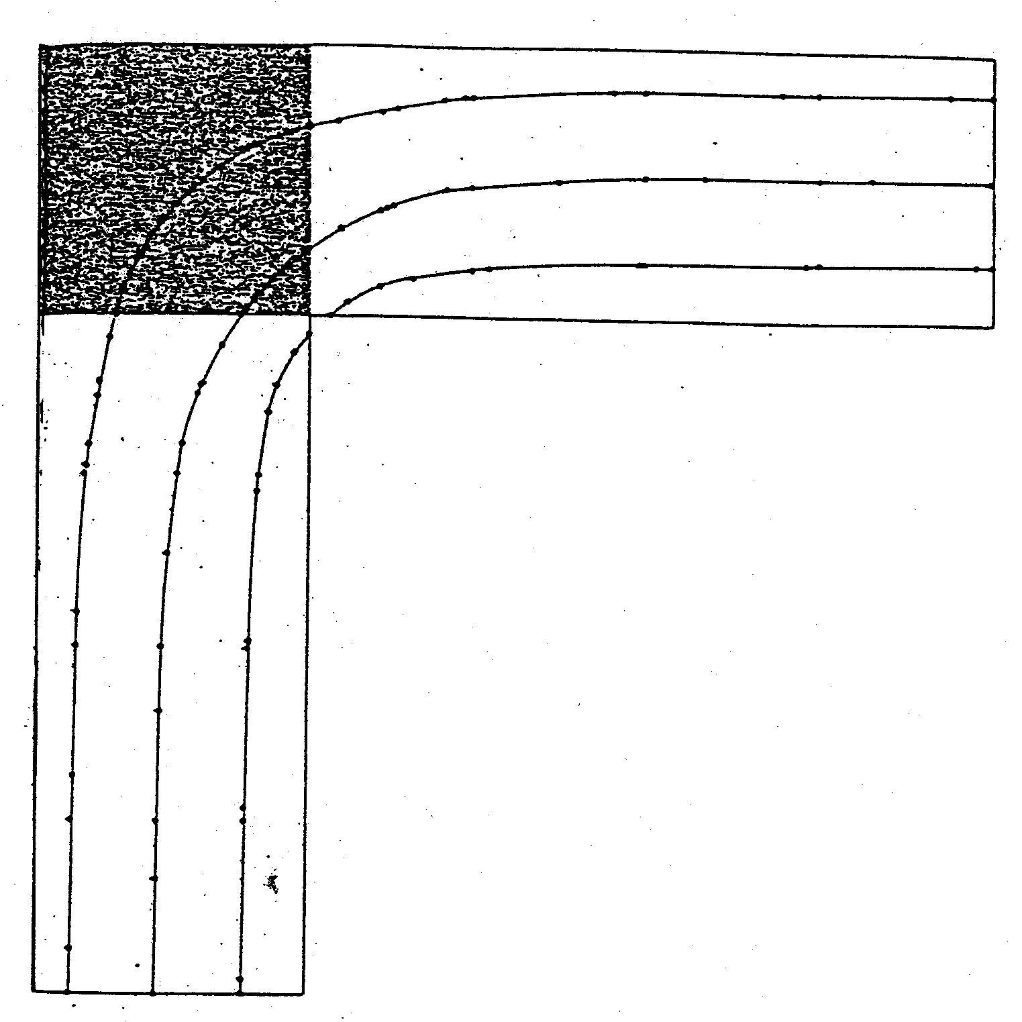
THERMAL BRIDGE EFFECTS
Isotherms in a corner area between two walls of equal structure

Slide 23
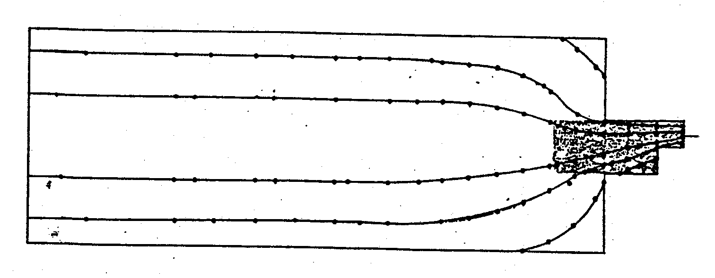
THERMAL BRIDGE EFFECTS
Isotherms in a joint between an outer wall and a casing

Slide 24
THERMAL BRIDGE EFFECTS
When the outside temperature is much lower than the inside temperature and the relative humidity inside the room is very high
⇓
The internal temperature can be lower than the dewpoint temperature
⇓
Condensation of water vapor in the air and / or phenomena thermophoresis

Slide 25
THERMAL BRIDGES EFFECTS
Thermophoresis
Migration of the particles in the air to the surfaces caused by the temperature difference or temperature gradient.
physical mechanism that contributes to aging of the products.
The surfaces colder than the surrounding air continuously capture the dust creating damaging deposits to the preservation of the objects.
In particular, condensation of the intrados of the floor in correspondence with the concrete rib.

Slide 26
THERMAL BRIDGES EFFECTS
The heat flux Increases
⇓
Thermal bridges determine a greater dispersion of energy from the inside to the outside

Slide 27
THERMAL BRIDGES EFFECTS
Condensation determines problems caused by damp patches and
⇓
it determines a decrease of the mechanical and physical characteristics of the wall materials

Slide 28
THERMAL BRIDGES EFFECTS
The methodology to avoid the main problems due to a thermal bridge is :
determine the temperature field in the thermal bridge area
verify that the values of the internal surface temperatures are greater than the dewpoint (temperature), T_{r}
in case this is not verified it should proceed to the thermal bridge correction with suitable constructive operations
calculate the heat transfer rate dispersed by the thermal bridge whether it was correct or not

Slide 29
METHODS TO REDUCE THERMAL BRIDGES
A thermal bridge can be eliminated or reduced by a suitable insulation
⇓
It is reduced the dispersed heat flux
⇓
It should be limited the effect of the temperature decrease of the on the inner surface of wall

Slide 30
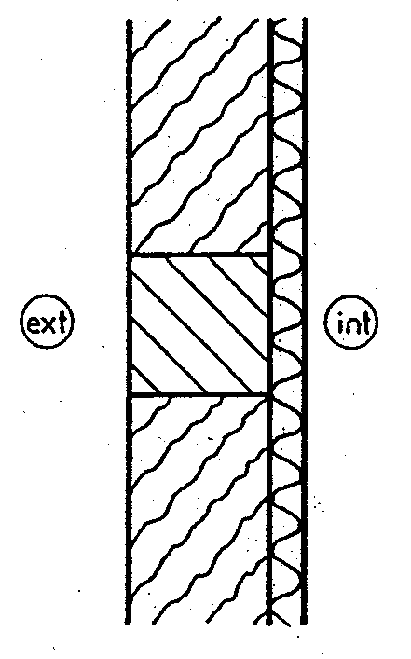
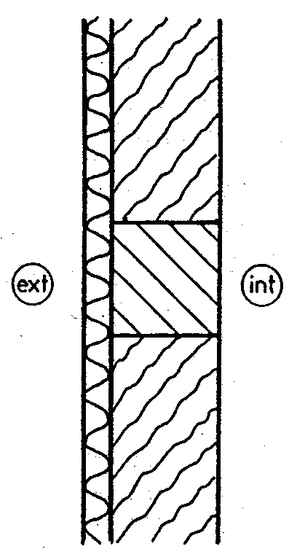
METHODS TO REDUCE THERMAL BRIDGES
It is reduced the dispersed heat flux
by means of thermal insulation
Internal thermal insulation
External thermal insulation

Slide 31
METHODS TO REDUCE THERMAL BRIDGES
If the thermal insulation is not perfectly continuous in correspondence with the thermal bridge
⇓
The deviation from the one-dimensional flow condition is further accentuated

Slide 32
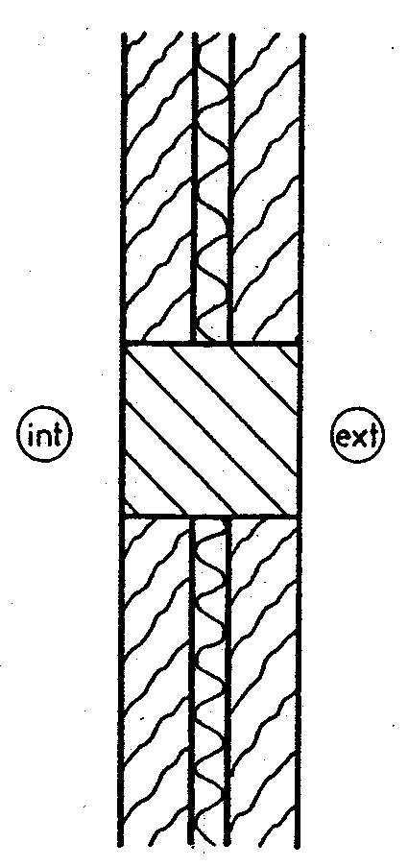
METHODS TO REDUCE THERMAL BRIDGES
Thermal insulation inside the wall

Slide 33
METHODS TO REDUCE THERMAL BRIDGES
It is not always possible to realize a continuous insulation due to architectural or constructional constraints
⇓
There should be a suitable superposition of two layers of insulation in staggered arrangement

Slide 34
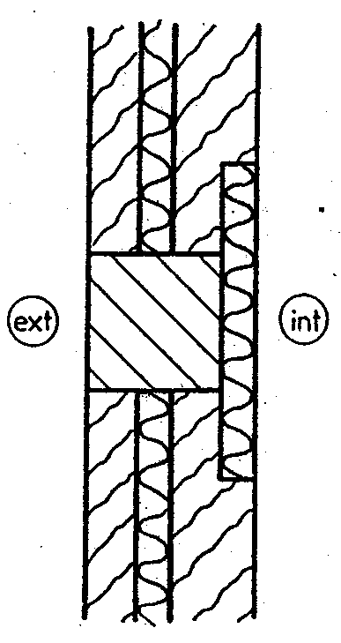
METHODS TO REDUCE THERMAL BRIDGES
Two layers of insulation in staggered arrangement
Internal thermal insulation
Thermal insulation inside the wall

Slide 35
THERMAL BRIDGE HEAT TRANSFER RATE EVALUATION
The study of heat transfer in the areas of thermal bridge is a heat conduction multidimensional problem in steady state regime

Slide 36
HEAT CONDUCTION EQUATION
Hypotheses:
Steady state regime
Internal generation equal to zero
Constant thermal conductivity (independent on temperature)
⇓

Slide 37
⇓
For assigned material, the solution is a function of boundary conditions associated with the examined problem

Slide 38
For applications concerning the thermal bridge areas in the buildings, the boundary conditions are typically the following:
heat flux continuity on interface surfaces between the examined domain and the external and internal environments
conductive heat flux and temperature continuity at the interface between non-homogeneous layers
one-dimensional heat flux imposed at a distance L_{p}. With L_{p} the length of influence where for higher distances the thermal bridge effects are negligible

Slide 39
heat flux continuity on interface surfaces between the examined domain and the external and internal environments

Slide 40
conductive heat flux and temperature continuity at the interface between non-homogeneous layers

Slide 41
one-dimensional heat flux imposed at a distance L_{p}. With L_{p} the length of influence where for higher distances the thermal bridge effects are negligible

Slide 42
⇓
The complexity of the geometry and the boundary conditions involves that the determination of the analytical solution present considerable difficulties

Slide 43
⇓
The solution of the problem is obtained by the aid of numerical methods

Slide 44
The commonly used numerical methods are those differences, volumes and finite elements
⇓
The partial differential equation of conduction is approximated with a system of linear algebraic equations in the unknowns temperatures in a finite number of nodes, in which the domain was discretized

Slide 45
⇓
The resolution of this system allows to evaluate the temperature range of the thermal bridge in the zone, and then to verify whether or not condensation phenomena occur at the interface with the internal environment

Slide 46
Evaluated the thermal field, it is possible to evaluate the heat transfer rate dispersed by the thermal bridge as a function of the internal or external surface temperatures
⇓

Slide 47
Total number of nodes on the inner surface of the thermal bridge
Surface temperature of the j-th node
Air temperature of indoor enviroment
Surface conductance, convective + radiative
Coordinate of the j-th node

Slide 48
The evaluation heat transfer rate dispersed allows to calculate the linear transmission coefficient or the linear conductance coefficient
⇓
The linear transmission coefficient or linear conductance coefficient, k_{L}, is defined as the rate of thermal energy per unit of characteristic length of the thermal bridge, and per unit of temperature difference between the inside and the outside of the structure

Slide 49
⇓
Difference between the total heat transfer rate dispersed by the thermal bridge area and the heat transfer rate calculated in one-dimensional scheme for the same structure
External air temperature

Slide 50
⇓
It is the increase in heat transfer rate compared to the one-dimensional flux condition for the thermal bridge area

Slide 51
⇓
Characteristic length dependent on the type of thermal bridge

Slide 52
In building the architectural types that generate thermal bridges are repeatable
⇓
Empirical relations or tables have been obtained which allow the determination of the coefficient k_{L} for the most common types of thermal bridges
⇓

Slide 53
THERMAL BRIDGE STANDARD OR REFERENCES
In general, using empirical methods, it is evaluated the heat transfer rate dispersed or the conductive trasmittance or conductance of some thermal bridges

Slide 54
CLASSIFICATION OF WALLS
Walls with internal thermal insulation
Walls with external thermal insulation
Walls with distributed thermal insulation
Sandwich walls with concrete and insulating material
External wall with lightweight facade

Slide 55
CLASSIFICATION OF WALLS
Walls with internal thermal insulation
⇓
Walls satisfying the following conditions:
the thermal insulation is assured almost exclusively from a material of thermal conductivity lower than 0.12 W/mK
the insulation thickness is such that its thermal resistance is higher than 0.5 m² K/W
the thermal insulation is placed on the inner surface of the wall

Slide 56
CLASSIFICATION OF WALLS
Walls with external thermal insulation
⇓
Walls satisfying the following conditions:
the thermal insulation is assured almost exclusively from a material of thermal conductivity lower than 0.12 W/mK
the insulation thickness is such that its thermal resistance is higher than 0.5 m² K/W
the thermal insulation is placed on the outer surface of the wall

Slide 57
CLASSIFICATION OF WALLS
Walls with distributed thermal insulation
⇓
This category includes:
walls which do not have thermal insulation
walls in which the thermal insulation is not disposed on either the outer surface or on the inner surface

Slide 58
CLASSIFICATION OF WALLS
Sandwich walls with concrete and insulating material
⇓
These walls consist of two concrete layers separated by a core of insulating material

Slide 59
CLASSIFICATION OF WALLS
External wall with lightweight facade
⇓
It is meant an outer wall of much lower thickness than conventional walls

Slide 60
Junction between the wall and the window frame
The evaluation of linear transmission coefficient k_{L} is a function of the wall according to the classification carried out and of the frame position with respect to the masonry.
The following cases are considered :
frame with the edge on the internal surface of the wall
Internal frame placed inside the opening of the walls
frame with the edge on the external surface of the wall

Slide 61
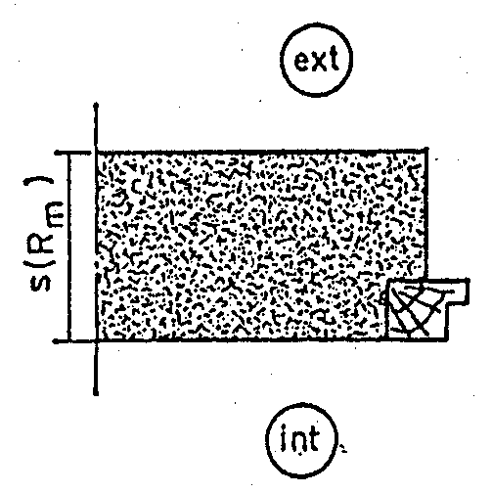
Junction between the wall and the window frame
Frame with the edge on the internal surface of the wall
distributed thermal insulation
wall thickness
thermal resistance of the wall in correspondence of the window opening

Slide 62
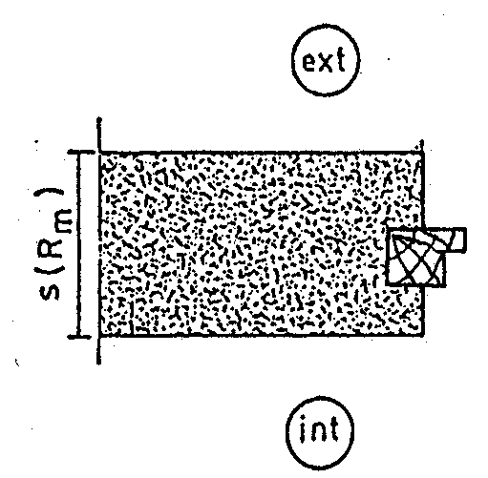
Junction between the wall and the window frame
Internal frame placed inside the opening of the walls
distributed thermal insulation
wall thickness
thermal resistance of the wall in correspondence of the window opening

Slide 63
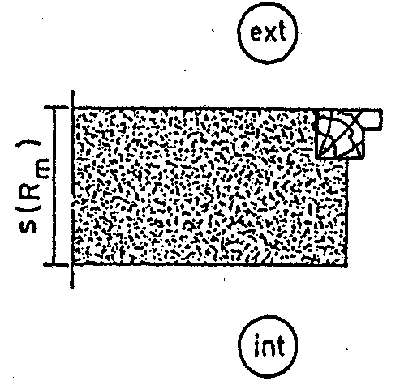
Junction between the wall and the window frame
Frame with the edge on the external surface of the wall
distributed thermal insulation
wall thickness
thermal resistance of the wall in correspondence of the window opening

Slide 64
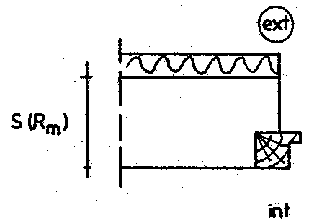
Junction between the wall and the window frame
Frame with the edge on the internal surface of the wall
wall thickness
external thermal insulation interrupted at the jamb
thermal resistance of the inner wall without insulation excluding the internal superficial thermal resistance

Slide 65
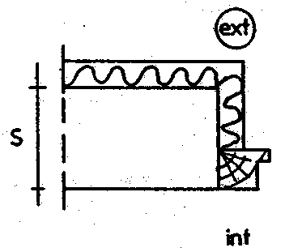
Junction between the wall and the window frame
Frame with the edge on the internal surface of the wall
external thermal insulation that covers the jamb
unitary transmittance of the wall

Slide 66
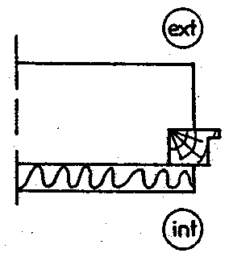
Junction between the wall and the window frame
Frame with the edge on the internal surface of the wall
internal thermal insulation that covers the jamb

Slide 67
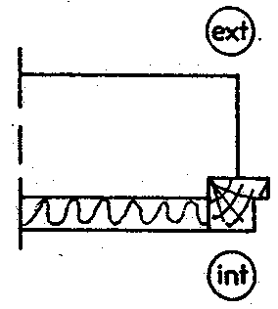
Junction between the wall and the window frame
Frame with the edge on the internal surface of the wall
internal thermal insulation interrupted at the jamb

Slide 68
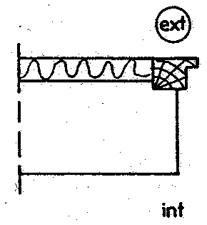
Junction between the wall and the window frame
Frame with the edge on the external surface of the wall
external thermal insulation interrupted at the jamb

Slide 69
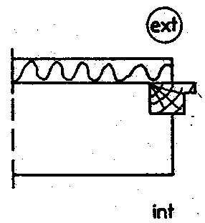
Junction between the wall and the window frame
Frame with the edge on the external surface of the wall
external thermal insulation that covers the jamb

Slide 70
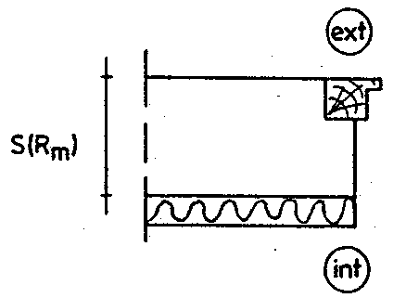
Junction between the wall and the window frame
Frame with the edge on the external surface of the wall
wall thickness
internal thermal insulation interrupted at the jamb
thermal resistance of the inner wall without insulation excluding the external superficial thermal resistance

Slide 71
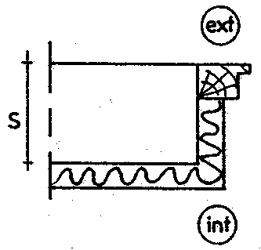
Junction between the wall and the window frame
Frame with the edge on the external surface of the wall
external thermal insulation that covers the jamb
unitary transmittance of the wall

Slide 72
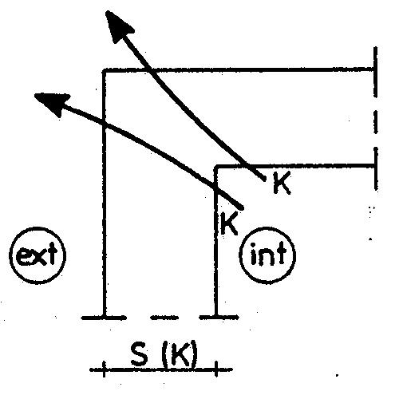
Edge constituted by two external walls
Identical walls
distributed thermal insulation
wall thickness
unitary transmittance of the wall

Slide 73
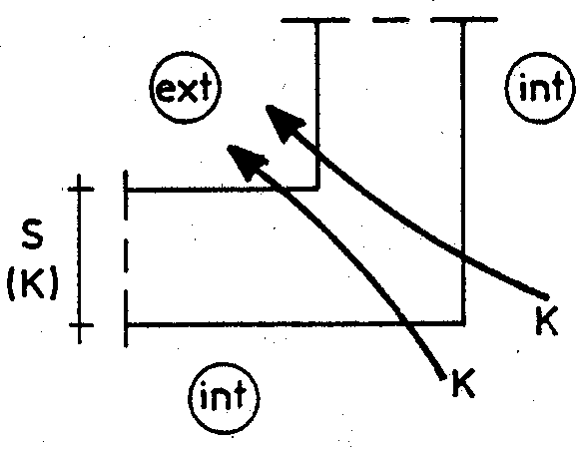
Edge constituted by two external walls
Identical walls
distributed thermal insulation
wall thickness
unitary transmittance of the wall

Slide 74
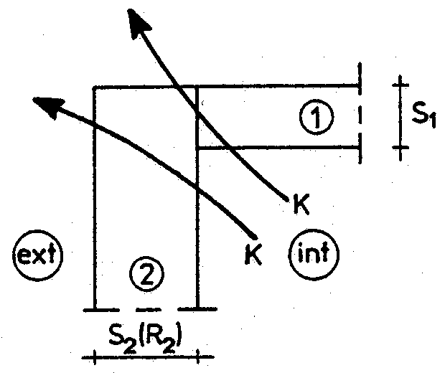
Edge constituted by two external walls
One wall forms the edge
distributed thermal insulation
mean value of thicknesses
thermal resistance of the wall which forms the edge

Slide 75
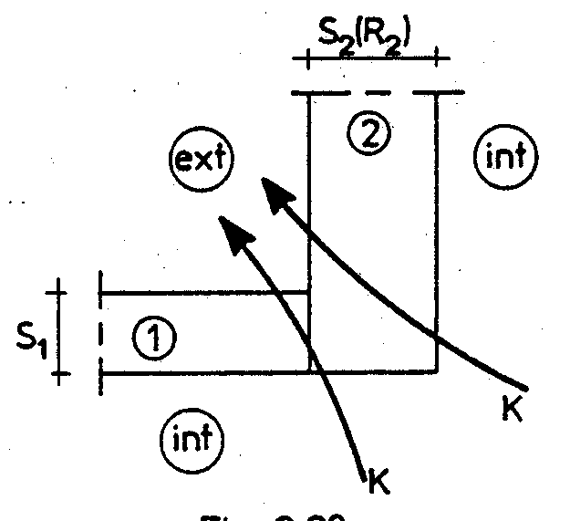
Edge constituted by two external walls
One wall forms the edge
distributed thermal insulation
mean value of thicknesses
thermal resistance of the wall which forms the edge

Slide 76
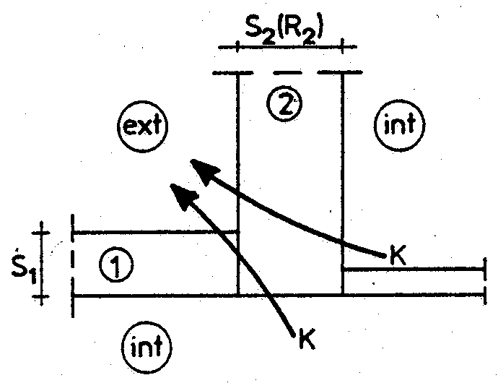
Edge constituted by two external walls
One wall forms the edge
distributed thermal insulation
mean value of thicknesses
thermal resistance of the wall which forms the edge

Slide 77
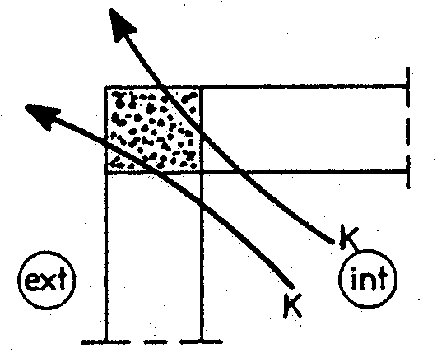
Edge constituted by two external walls
Concrete pillar
distributed thermal insulation
mean value of thicknesses

Slide 78
THERMAL BRIDGES FRENCH STANDARD
C.S.T.B. Th-k77
To facilitate the designer work, the French legislation provides tables for the determination of linear transmittance, k_{L}, for a very large sample of thermal bridges and some examples are given in the next slides

Slide 79
THERMAL BRIDGES FRENCH STANDARD
In these tables is assumed:
for insulation material with thermal conductivity no greater than 0.065 W/mK and of a thickness such that its thermal resistance is not lower than 0.50 m² K/W

Slide 80
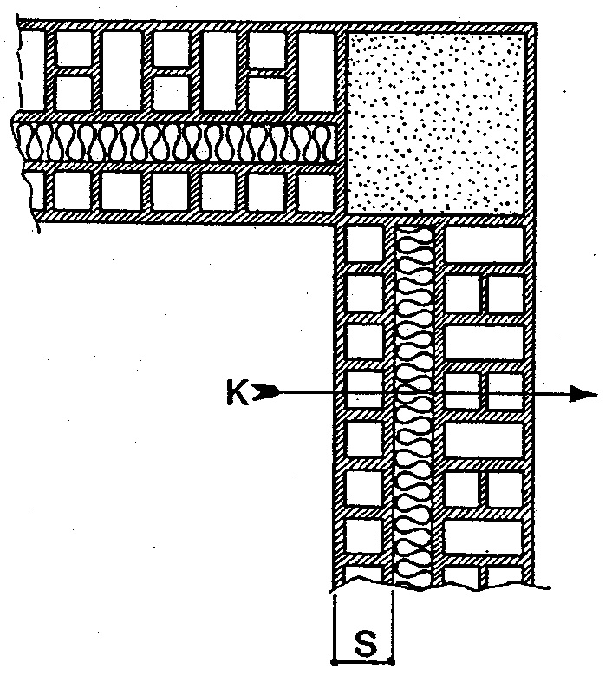
Junction between two outer walls with corner pillar - interrupted insulation

Slide 81
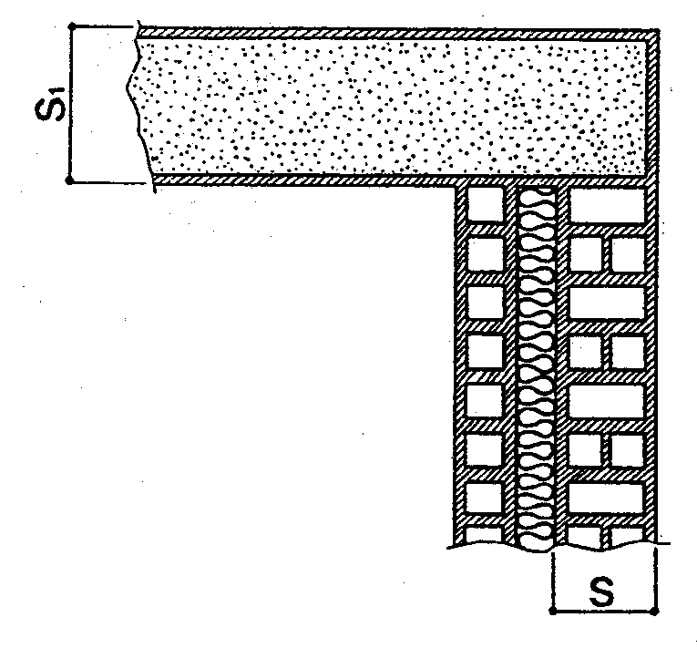
Joint between two outer walls with one insulated

Slide 82
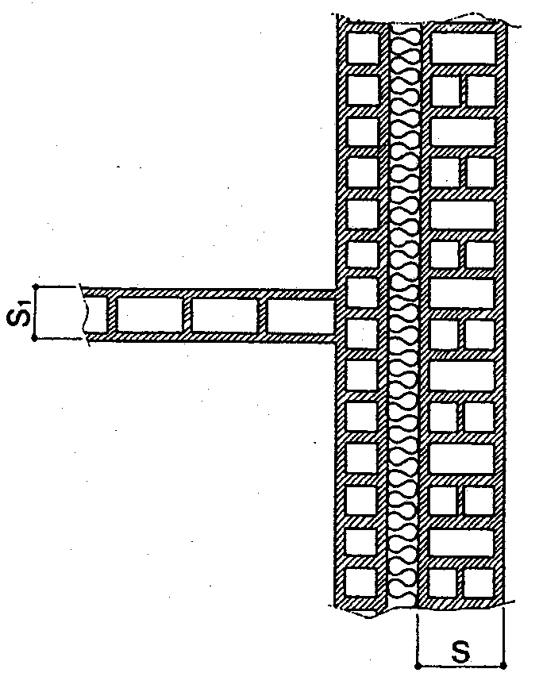
Joint outer wall with continuous insulation - internal partition

