Slide 1
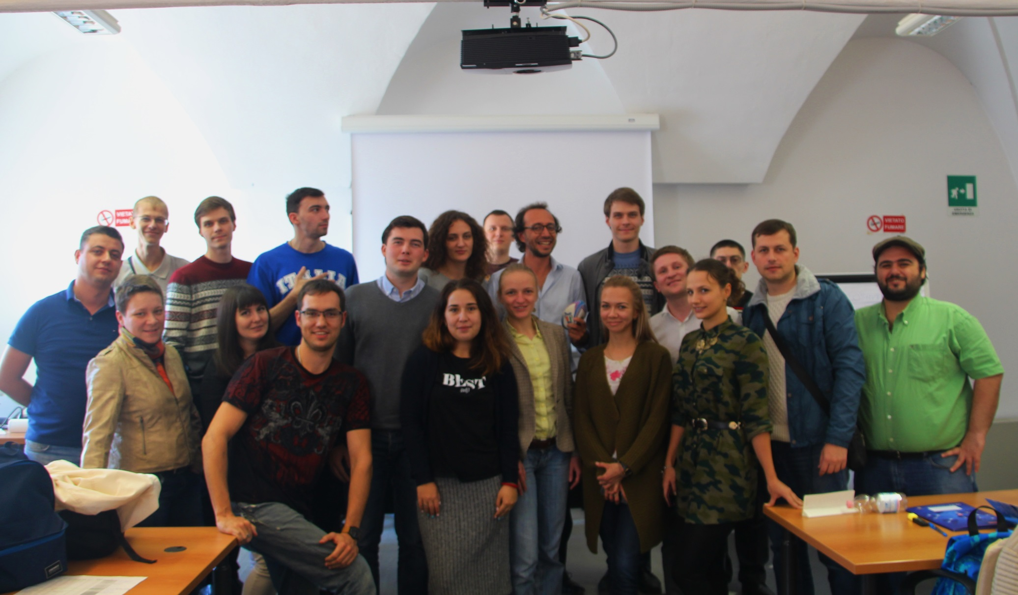
Master Degree in Innovative Technologies in Energy Efficient Buildings for Russian & Armenian Universities and Stakeholders

