Slide 1
Master Degree in Innovative Technologies in Energy Efficient Buildings for Russian & Armenian Universities and Stakeholders - LeSSON 2 – CONCEPTS AND DEFINITIONS
10-10-2016
Prof. Ing. Flavio Tonelli

Slide 2
Introduction
Organizational theory and management philosophies have undergone a dramatic change in recent years with the emergence of the project management approach to management. Because project management is an outgrowth of systems management, it is only fitting that the underlying principles of general systems theory be described. Simply stated, general systems theory can be classified as a management approach that attempts to integrate and unify scientific information across many fields of knowledge. Systems theory attempts to solve problems by looking at the total picture, rather than through an analysis of the individual components.
Today we use the PMBOKTM to satisfy this need for project management. General systems theory implies the creation of a management technique that is able to cut across many organizational disciplines—finance, manufacturing, engineering, marketing, and so on—while still carrying out the functions of management.
This technique has come to be called systems management, project management, or matrix management (the terms are used interchangeably).

Slide 3
Project Management
The growth of project management has come about more through necessity than through desire.
Between the middle and late 1960s, more and more executives began searching for new management techniques and organizational structures that could be quickly adapted to a changing environment.
Type of Industry | Task | Environment
A | Simple | Dynamic
B | Simple | Static
C | Complex | Dynamic
D | Complex | Static

Slide 4
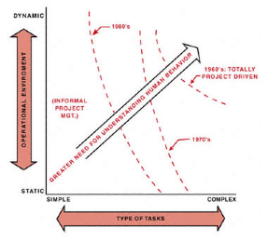
Project Management
Almost all type C and most type D industries have project management–related structures.
Companies that have complex tasks and that also operate in a dynamic environment find project management mandatory. Such industries would include aerospace, defense, construction, high-technology engineering, computers, and electronic instrumentation.

Slide 5
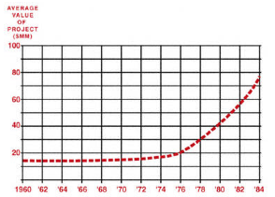
Project Management
Other than aerospace, defense, and construction, the majority of the companies in the 1960s maintained an informal method for managing projects. In informal project management, just as the words imply, the projects were handled on an informal basis whereby the authority of the project manager was minimized.
By 1970 and again during the early 1980s, more and more companies departed from informal project management and restructured to formalize the project management process, mainly because the size and complexity of their activities had grown to a point where they were unmanageable within the current structure.

Slide 6
Project Management
Questions to be analysed to give some insight as to whether formal project management is necessary:
Are the jobs complex?
Are there dynamic environmental considerations?
Are the constraints tight?
Are there several activities to be integrated?
Are there several functional boundaries to be crossed?
If any of these questions are answered yes, then some form of formalized project management may be necessary. It is possible for formalized project management to exist in only one functional department or division, such as for R&D or perhaps just for certain types of projects.
Project management restructuring permitted companies to:
Accomplish tasks that could not be effectively handled by the traditional structure
Accomplish onetime activities with minimum disruption of routine business; the major problems identified by those managers who endeavored to adapt to the new system all resolved about conflicts in authority and resources.

Slide 7
Project Management
Three major problems:
Project priorities and competition for talent may interrupt the stability of the organization and interfere with its long-range interests by upsetting the normal business of the functional organization.
Long-range planning may suffer as the company gets more involved in meeting schedules and fulfilling the requirements of temporary projects.
Shifting people from project to project may disrupt the training of new employees and specialists.
Project management required upper-level managers to relinquish some of their authority through delegation to the middle managers.
Driving forces:
The time span between project initiation and completion appears to be increasing.
The capital committed to the project prior to the use of the end item appears to be increasing.
As technology increases, the commitment of time and money appears to become inflexible.
Technology requires more and more specialized manpower.
The inevitable counterpart of specialization is organization.
The above five "imperatives" identify the necessity for more effective planning, scheduling, and control.

Slide 8
Project Management
Researchers conducted two three-day seminars on engineering project management for seventy-five of the lower-, middle-, and upper-level managers
"Will I have more or less power and/or authority?”
"How will my salary be affected?”
"Why should I permit a project manager to share the resources in my empire?”
"Will I get top management visibility?"
The final decision for the implementation of project management does (and will always) rest with executive management.
Executives must be willing to listen when middle management identifies a crisis in controlling resources. This is where the need for project management should first appear.
Executives are paid to look out for the long-range interest of the corporation and should not be swayed by near-term growth rate or profitability.

Slide 9
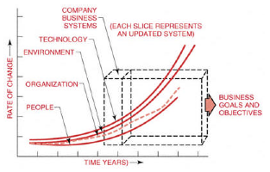
Project Management
Even though an executive can change the organizational structure with the stroke of a pen, people are responsible for its implementation. However, it can be that people have the slowest rate of change. Edicts, documents signed by executives, and training programs will not convince employees that a new organizational form will work. Employees will be convinced only after they see the new system in action, and this takes time.
As a ground rule, it often takes two to three years to convert from a traditional structure to a project management structure.

Slide 10
Project Management
The literature describes many cases where project management has failed because:
There was no need for project management.
Employees were not informed about how project management should work.
Executives did not select the appropriate projects or project managers for the first few projects.
There was no attempt to explain the effect of the project management organizational form on the wage and salary administration program.
Employees were not convinced that executives were in total support of the change.

Slide 11
Example (1/3)
Highly traditional company that purchased a computer a few years ago.
The company has five divisions: engineering, finance, manufacturing, marketing, and personnel.
Not knowing where to put the computer, the chief executive officer created an electronic data processing (EDP) department and placed it under finance and accounting. The executive's rationale was that since the purpose for buying the computer was to eliminate repetitive tasks and the majority of these were in accounting and finance, that was where EDP belonged. The vice president for accounting and finance might not be qualified to manage the EDP department, but that seemed beside the point.
The EDP department has a staff of scientific and business computer programmers and systems analysts. The scientific programmers spend almost all their time working in the engineering division writing engineering programs; they must learn engineering in order to do this. In this company, the engineer does not consider himself to be a computer programmer, but does the computer programmer consider himself to be an engineer?

Slide 12
Example (2/3)
The company's policy is that merit and cost-of-living increases are given out in July of each year. This year the average salary increase will be 7 percent. However, the president wants the increase given according to merit, and not as a flat rate across the board.
After long hours of deliberation, it was decided that engineering, manufacturing, and marketing would receive 8 percent raises, and finance and personnel 5.5 percent.
After announcement of the salary increases, the scientific programmers began to complain because they felt they were doing engineering-type work and should therefore be paid according to the engineering pay scale.
Management tried to resolve this problem by giving each division its own computer and personnel.
However, this resulted in duplication of effort and inefficient use of personnel. With the rapid advancements in computer technology of recent years, management realized the need for timely access to information for executive decision making. In a rather bold move, executives created a new division called management information systems (MIS).

Slide 13
Example (3/3)
The MIS division now has full control of all computer operations and gives the EDP personnel the opportunity to show that they actually contribute to corporate profits.
Elevating the computer to the top levels of the organization was a significant step toward project management. Unfortunately, many executives did not fully realize what had happened. Because of the need for a rapid information retrieval system that can integrate data from a variety of line organizations, the MIS personnel soon found that they were working horizontally, not vertically.
Today, MIS packages cut across every division of the company. Thus, the project management concept for handling a horizontal flow of work emerged.
With the emergence of data processing project management, executives were forced to find immediate answers to such questions as:
Can we have project management strictly for data processing projects?
Should the project manager be the programmer or the user?
How much authority should be delegated to the project manager, and will this delegated authority cause a shift in the organizational equilibrium?
The answers to these questions have not been and still are not easy to solve. Today, IBM provides its customers with the opportunity to hire IBM as the in-house data processing project management team. This partially eliminates the necessity for establishing internal project management relationships that could easily become permanent.

Slide 14
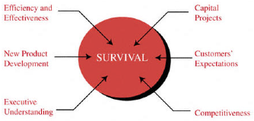
Project Management

Slide 15
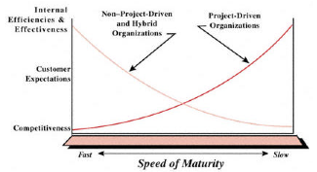
Project Management

Slide 16
Phases of Project Management implementation
FIRST PHASE: organizations perceive the need for project management;
SECOND PHASE: Executive Support. Project management cannot be implemented rapidly in the near term without executive support. Furthermore, the support must be visible to all.
THIRD PHASE: Line Management Support. It is highly unlikely that any line manager would actively support the implementation of project management without first recognizing the same support coming from above. Even minimal line management support will still cause project management to struggle.
FOURTH PHASE: Growth Phase, where the organization becomes committed to the development of the corporate tools for project management. This includes the project management methodology for planning, scheduling, and controlling, as well as selection of the appropriate supporting software. Portions of this phase can begin during earlier phases.
FIFTH PHASE: Maturity. In this phase, the organization begins using the tools developed in the previous phase. Here, the organization must be totally dedicated to project management. The organization must develop a reasonable project management curriculum to provide the appropriate training and education in support of the tools, as well as the expected organizational behavior.

Slide 17
Benefits of Project Management
Past View | Present View
PM will require more people and to add to the overhead cost | PM allows us to accomplish more work in less time and with less people
Profitability may decrease | Profitability may increase
PM will increase the amount of scope changes | PM will provide better control od scope changes
PM creates organizational instability and increases conflicts | PM makes the organization more efficient and effective though better organizational behaviour principles
PM is really “eye wash” for the customer’s benefits | PM will allow us to work more closely with our customes
PM will create problems | PM provides a means for solving problems
Only large projects need PM | All project will benefits from PM
PM will increase quality problems | PM increases quality
PM will create power and authority problems | PM will reduce power struggles
PM focuses on suboptimization by looking at only the project | PM allows people to make good company decisions
PM delives products to a customer | PM delivers solutions
The cost of PM may make us noncompetitive | PM will increase our business

Slide 18
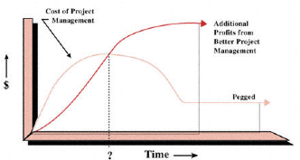
Benefits of Project Management

Slide 19
Agenda
Project Management Growth: Concepts and Definitions
Resistence to change
Systems, programs, projects
Methodologies

Slide 20
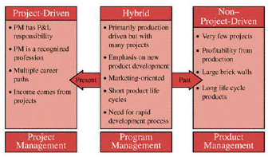
Resistence to change
Historically, project management resided only in the project-driven sectors of the marketplace. In these sectors, the project managers were given the responsibility for profit and loss. This profit and loss (P&L) responsibility virtually forced companies to treat project management as a profession.
In the non–project-driven sectors of the marketplace, corporate survival was based upon products and services, rather than upon a continuous stream of projects. Profitability was identified through marketing and sales, with very few projects having an identifiable P&L. As a result, project management in these firms was never viewed as a profession.

Slide 21
Acceptance of PM
1985: Companies recognize that they must compete on the basis of quality as well as cost. There exists a new appreciation for total quality management (TQM). Companies begin using the principles of project management for the implementation of TQM. The first ally for project management surfaces with the "marriage" of project management and TQM.
1990: During the recession of 1989–1993, companies recognize the importance of schedule compression and being the first to market. Advocates of concurrent engineering begin promoting the use of project management to obtain better scheduling techniques. Another ally for project management is born.
1991–1992: Executives realize that project management works best if decision-making and authority are decentralized. Executives recognize that control can still be achieved at the top by functioning as project sponsors.
1993: As the recession of 1989–1993 comes to an end, companies begin "re-engineering" the organization, which really amounts to elimination of organizational "fat." The organization is now a "lean and mean" machine. People are asked to do more work in less time and with fewer people; executives recognize that being able to do this is a benefit of project management.

Slide 22
Acceptance of PM
1994: Companies recognize that a good project cost control system (i.e., horizontal accounting) allows for improved estimating and a firmer grasp of the real cost of doing work and developing products.
1995: Companies recognize that very few projects are completed within the framework of the original objectives without scope changes. Methodologies are created for effective change management.
1996: Companies recognize that risk management involves more than padding an estimate or a schedule. Risk management plans are now included in the project plans.
1997-1998: The recognition of project management as a professional career path mandates the consolidation of project management knowledge and a centrally located project management group. Benchmarking for best practices forces the creation of centers for excellence in project management.

Slide 23
Acceptance of PM
1999: Companies that recognize the importance of concurrent engineering and rapid product development find that it is best to have dedicated resources for the duration of the project. The cost of overmanagement may be negligible compared to risks of undermanagement. More and more organizations can be expected to use colocated teams all housed together.
2000: Mergers and acquisitions are creating more multinational companies. Multinational project management will become the major challenge for the next decade.
As project management continues to grow and mature, more allies will appear. In the twenty-first century, second and third world nations will come to recognize the benefits and importance of project management. Worldwide standards for project management will occur. .

Slide 24
Agenda
Project Management Growth: Concepts and Definitions
Resistence to change
Systems, programs, projects
Methodologies

Slide 25
Systems
Military and government organizations were the first to attempt to define clearly the boundaries of systems, programs, and projects.
A group of elements, either human or nonhuman, that is organized and arranged in such a way that the elements can act as a whole toward achieving some common goal, objective, or end.
Air Force Definition: A composite of equipment, skills, and techniques capable of performing and/or supporting an operational role. A complete system includes related facilities, equipment, material services, and personnel required for its operation to the degree that it can be considered as a self-sufficient unit in its intended operational and/or support environment.
NASA Definition: One of the principal functioning entities comprising the project hardware within a project or program. The meaning may vary to suit a particular project or program area. Ordinarily a "system" is the first major subdivision of project work (spacecraft systems, launch vehicle systems).

Slide 26
Program
Programs can be construed as the necessary first-level elements of a system.
Air Force Definition: The integrated, time-phased tasks necessary to accomplish a particular purpose.
NASA Definition: A relative series of undertakings that continue over a period of time (normally years) and that are designed to accomplish a broad, scientific or technical goal in the NASA long-range plan (lunar and planetary exploration, manned spacecraft systems).
Programs can be regarded as subsystems. However, programs are generally defined as time-phased efforts, whereas systems exist on a continuous basis..

Slide 27
Projects
Projects are also time-phased efforts (much shorter than programs) and are the first level of breakdown of a program.
NASA/Air Force Definition: A project is within a program as an undertaking that has a scheduled beginning and end, and that normally involves some primary purpose.
Once a group of tasks is selected and considered to be a project, the next step is to define the kinds of project units. There are four categories of projects:
Individual projects: These are short-duration projects normally assigned to a single individual who may be acting as both a project manager and a functional manager.
Staff projects: These are projects that can be accomplished by one organizational unit, say a department. A staff or task force is developed from each section involved. This works best if only one functional unit is involved.
Special projects: Very often special projects occur that require certain primary functions and/or authority to be assigned temporarily to other individuals or units. This works best for short-duration projects. Long-term projects can lead to severe conflicts under this arrangement.
Matrix or aggregate projects: These require input from a large number of functional units and usually control vast resources.

Slide 28
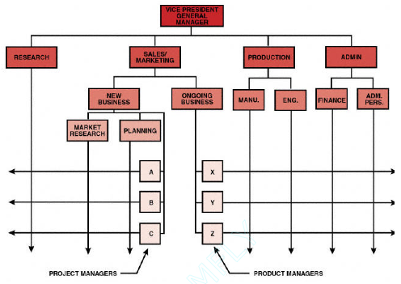
Product versus project management
For all practical purposes, there is no basic difference between product management and project management.
The project manager focuses on the end date of his project, whereas the product manager is not willing to admit that his product line will ever end.
When the project is in the R&D phase, a project manager is involved. Once the product is developed and introduced into the marketplace, control is taken over by the product manager.

Slide 29
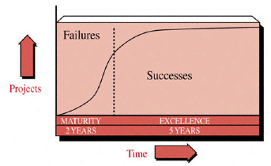
Maturity and exellence
Maturity in project management is the implementation of a standard methodology and accompanying processes such that there exists a high likelihood of repeated successes.
Maturity implies that the proper foundation of tools, techniques, processes, and even culture, exists. When projects come to an end, there is usually a debriefing with senior management to discuss how well the methodology was used and to recommend changes. This debriefing looks at ''key performance indicators," which are shared learning topics, and allows the organization to maximize what it does right and to correct what it did wrong.
Organizations excellent in project management are those that create the environment in which there exists a continuous stream of successfully managed projects and where success is measured by what is in the best interest of both the company and the project (i.e., customer).

Slide 30
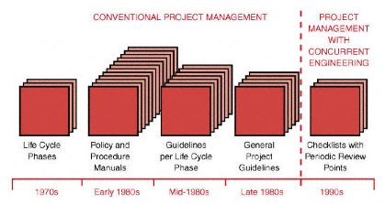
Informal project management
Companies today are managing projects more on an informal basis than on a formal one. Informal project management does have some degree of formality but emphasizes managing the project with a minimum amount of paperwork.
Informal project management is based upon guidelines rather than the policies and procedures that are the basis for formal project management.
A group of elements, either human or nonhuman, that is organized and arranged in such a way that the elements can act as a whole toward achieving some common goal, objective, or end.
Informal project management mandates:
Effective communications
Effective cooperation
Effective teamwork
Trust

Slide 31
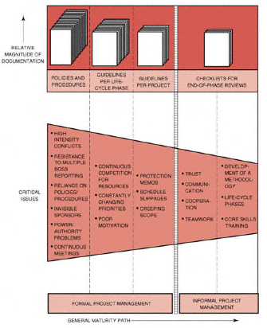
Informal project management

Slide 32
Project Life-Cycle
Every program, project, or product has certain phases of development.
The phases of development are known as life-cycle phases.
The theoretical definitions of the life-cycle phases of a system can be applied to a project.
Conceptual
Includes the preliminary evaluation of an idea. Most important in this phase is a preliminary analysis of risk and the resulting impact on the time, cost, and performance requirements, together with the potential impact on company resources. The conceptual phase also includes a "first cut" at the feasibility of the effort.
Planning
It is mainly a refinement of the elements described under the conceptual phase. The planning phase requires a firm identification of the resources to be required together with the establishment of realistic time, cost, and performance parameters. This phase also includes the initial preparation of all documentation necessary to support the system. For a project based on competitive bidding, the conceptual phase would include the decision of whether to bid, and the planning phase would include the development of the total bid package (i.e., time, schedule, cost, and performance).
• Testing • Implementation • Closure

Slide 33
Project Life-Cycle
Testing
Testing and final standardization effort so that operations can begin. Almost all documentation must be completed in this phase.
Implementation
It integrates the project's product or services into the existing organization. If the project was developed for establishment of a marketable product, then this phase could include the product life-cycle phases of market introduction, growth, maturity, and a portion of deterioration.
Closure
It includes the reallocation of resources. The question to be answered is, "Where should the resources be reassigned?" Consider a company that sells products on the open consumer market.

Slide 34
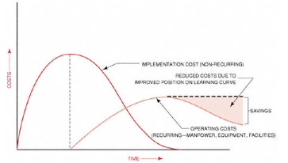
Project costs
Analyzing system costs during the conceptual and planning phases is not an easy task.
Most project or system costs can be broken down into operating (recurring) and implementation (nonrecurring) categories. The implementation costs include one-time expenses such as construction of a new facility, purchasing computer hardware, or detailed planning. Operating costs, on the other hand, include recurring expenses such as manpower.
The identification of a learning curve position is vitally important during the planning phase when firm cost positions must be established.

Slide 35
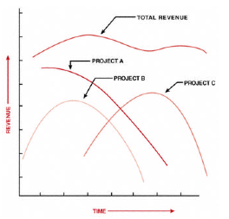
Closure of a project

Slide 36
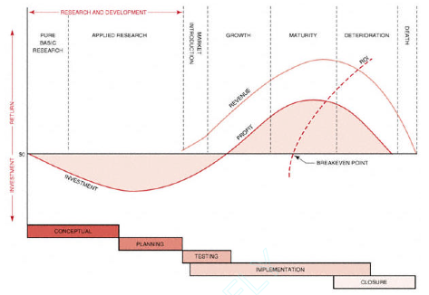
Exeptions

Slide 37
Project life-cycle summary
Engineering
Start-up
Computer programming
Conceptua
Construction
Planning, data gathering and procedures
Studies and basic engineering
Manufacturing
Definition
Main
termination
Formation
Buildup
Production
Phase-out
Final audit
Planning
Definition and design
Implementation
Conversion
Major review
Detailed engineering
Dataile engineering/construction overlap
Construction
Testing and commissioning

Slide 38
Agenda
Project Management Growth: Concepts and Definitions
Resistence to change
Systems, programs, projects
Methodologies

Slide 39
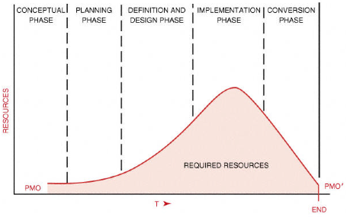
Methodologies

Slide 40
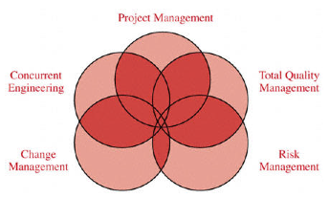
Methodologies
Project Management: The basic principles of planning, scheduling, and controlling work
Total Quality Management: The process of ensuring that the end result will meet the quality expectations of the customer
Concurrent Engineering: The process of performing work in parallel rather than series in order to compress the schedule without incurring serious risks
Scope Change Control: The process of controlling the configuration of the end result such that value added is provided to the customer
Risk Management: The process of identifying, quantifying, and responding to the risks of project without any material impact on the project's objectives

Slide 41
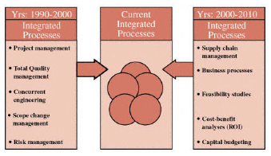
Methodologies

Slide 42
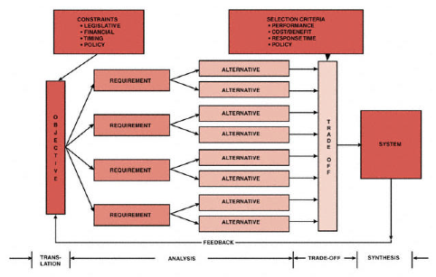
Systems thinking
The systems approach may be defined as a logical and disciplined process of problem-solving.
Forces review of the interrelationship of the various subsystems
Is a dynamic process that integrates all activities into a meaningful total system
Systematically assembles and matches the parts of the system into a unified whole
Seeks an optimal solution or strategy in solving a problem

Slide 43
Systems approach
The systems approach to problem-solving has the following phases of development
Translation: Terminology, problem objective, and criteria and constraints are defined and accepted by all participants.
Analysis: All possible approaches to or alternatives to the solution of the problem are stated.
Trade-off: Selection criteria and constraints are applied to the alternatives to meet the objective.
Synthesis: The best solution in reaching the objective of the system is the result of the combination of analysis and trade-off phases.
Other terms essential to the systems approach are as follows:
Objective: The function of the system or the strategy that must be achieved.
Requirement: A partial need to satisfy the objective.
Alternative: One of the selected ways to implement and satisfy a requirement.
Selection criteria: Performance factors used in evaluating the alternatives to select a preferable alternative.
Constraint: An absolute factor that describes conditions that the alternatives must meet.

